Slide 1
Inserting the Missing Character

Slide 2
In this chapter questions contain a figure, a set of figures, an arrangement or a matrix, each of which bears certain characters, be it numbers, letters or a group/combination of letters/numbers which follow a particular pattern. You are required to identify and decipher this pattern and accordingly find the missing character in the figure.

Slide 3


Example1 :
a) 7 b) 25 c) 49 d) 129

Slide 4


Example 2:
a) 45 b) 50 c) 60 d) 63

Slide 5
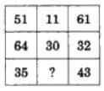
Practice Questions:
1.
25
27
32
37
Ans: B

Slide 6
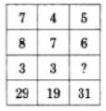
2.
3
4
5
6
Ans: C

Slide 7
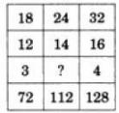
3.
2
3
4
5
Ans: B

Slide 8
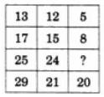
4.
7
9
11
15
Ans: A

Slide 9

5.
15
18
19
20
Ans: B

Slide 10

6.
19
17
16
15
Ans: C

Slide 11

7.
6
9
12
18
Ans: B

Slide 12

8.
25
37
41
47
Ans: C

Slide 13

9.
45
41
32
40
Ans: A

Slide 14
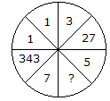
10.
25
625
125
50
Ans: C

Slide 15

11.
30
13
70
118
Ans: B

Slide 16

12.
60
46
86
75
Ans: C

Slide 17
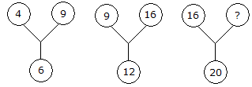
13.
60
50
25
21
Ans: C

Slide 18
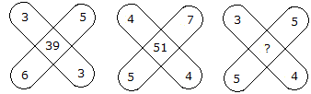
14.
47
45
37
35
Ans: C

Slide 19

15.
11
14
10
12
Ans: A

Slide 20


